Slide 1
Digital money – private and state
Cryptocurrencies and CBDC in the light of monetary theory and history
Lars Christensen

Slide 2
Agenda
The history of money
Cryptocurrencies
Central Bank Digital Currency (CBDC)

Slide 3
Functions of money
Medium of exchange
Store of value
unit of account

Slide 4
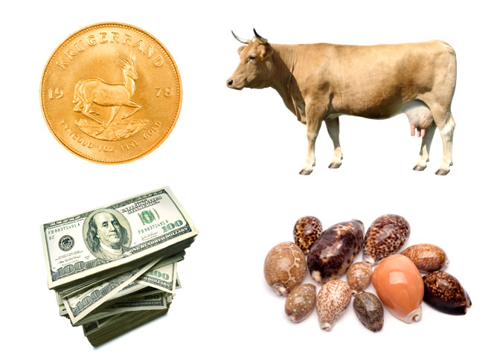
Money version 1.0 – Cattle and grain
(c 9000-6000 BC)

Slide 5
Technological progresss is key
Writing invented in Mesopotamia (c. 3100 BC)
The main use, and probable motivation for its development, is for keeping accounts.
Development of Banking in Mesopotamia (c. 3000 - c. 2000 BC)
Banking originates in Babylonia out of the activities of temples and palaces which provided safe places for the storage of valuables. Initially deposits of grain are accepted and later other goods including cattle, agricultural implements, and precious metals.

Slide 6
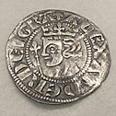
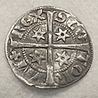
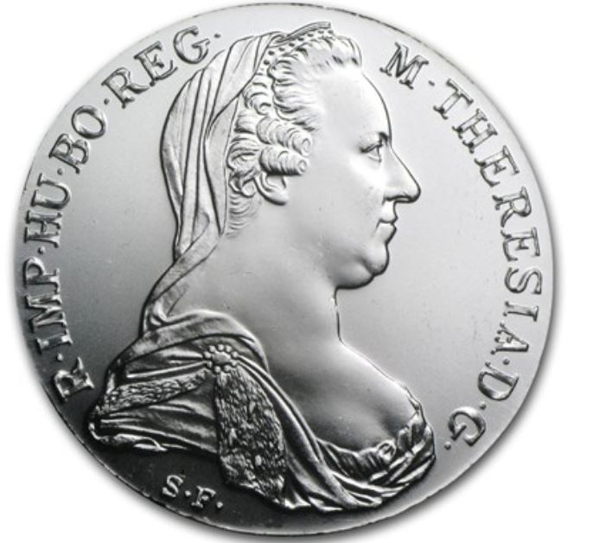
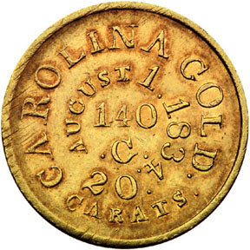
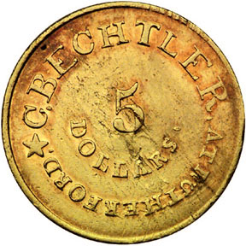
Money version 2.0 - precious metal coins

Slide 7
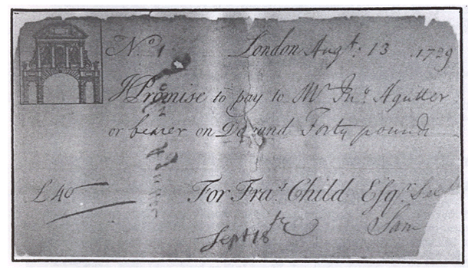
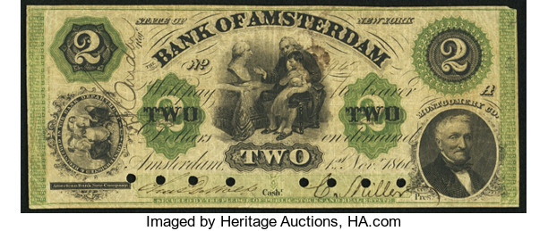
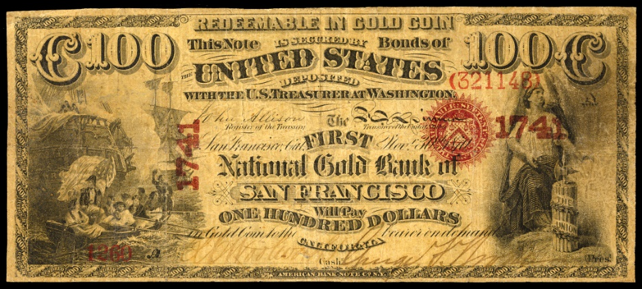
Money 3.0: Private IOUs redeemable for precious metal coin

Slide 8
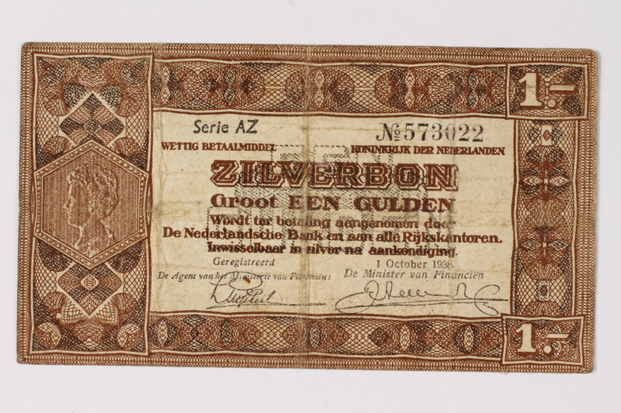
Money 3.1: Government IOUs redeemable for precious metal coin

Slide 9
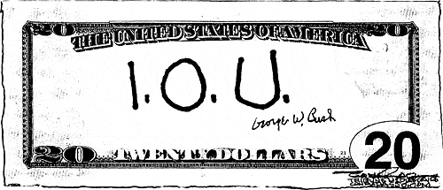
Currency 4.0: Government fiat currency
IOU NOTHING

Slide 10
Why will anybody accept fiat money?
Why does it have a positive value?
Why is there real demand for it?
Legal tender, receivable in taxes
… but inertia can be enough

Slide 11
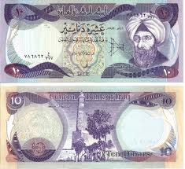
”Miracle money” …fiat money without legal tender laws
Soviet Union/Russia 1917-22
Stateless Somalia from January 1991 to August 2012
”Iraqi Swiss Dinar” after the first Gulf War

Slide 12
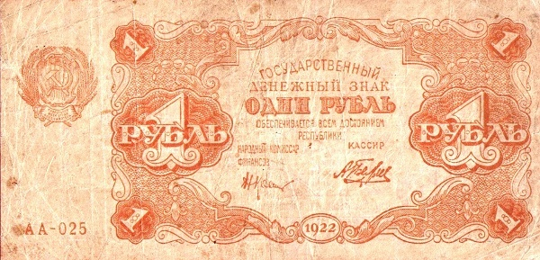
“It is remarkable that, under these circumstances, tsar notes, which were also called “Romanov” or “Nikolai” notes, were legal tender abroad, and circulated throughout the former Russian Empire.
Up until 1922, they were willingly accepted by the population, which considered them a “strong” currency, and were often kept for savings. Moreover, having its own purposes in mind, the Soviet government continued printing and issuing tsar notes for a number of years.”
”Money of the Russian Revolution 1917-1920”

Slide 13
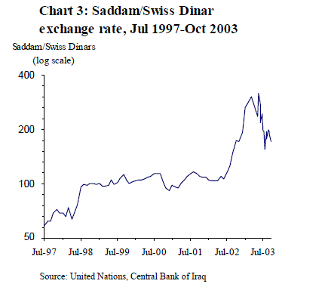
Iraqis trusted the ”Swiss Dinar” more than Saddam

Slide 14
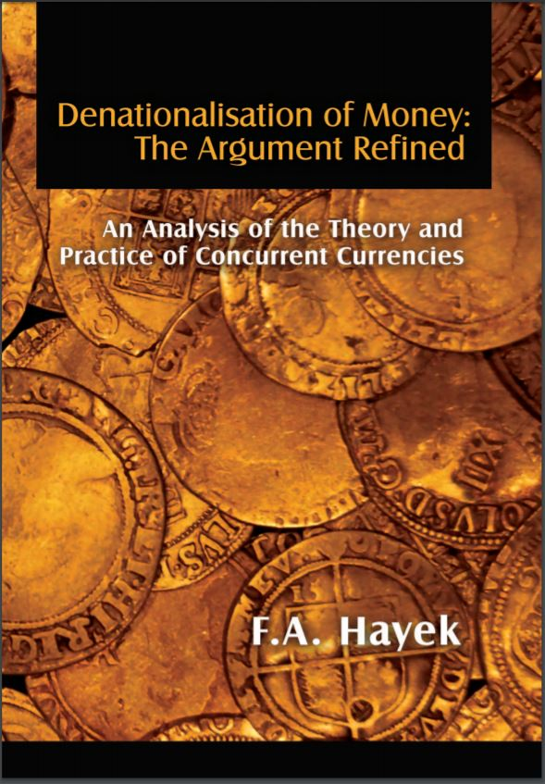
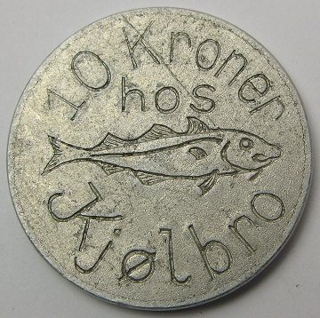
There is a long history of ‘private money’ and Free Banking

Slide 15
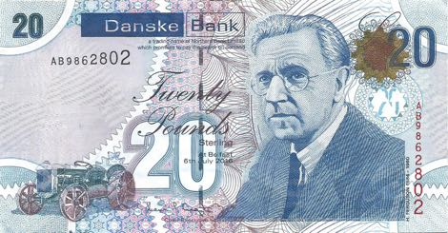
Danske Bank controls the Northern Irish printing press

Slide 16
Money 5.0: private digital “IOU nothing”

Slide 17
The Bitcoin project
Program launched 2009 as a hobby
Initially supported only by a community of enthusiasts
Now served by for-profit exchanges (Bitstamp, Coinbase, etc.) and payment processors (BitPay, Coinkite, etc.)
Who wrote the original program? “Satoshi Nakamoto,” a pseudonym

Slide 18
Early history of Bitcoin
Digicash (1983-1998): David Chaum’s project for issuing cryptographically secured (to block “double spending”) electronic currency, i.e. circulating e-banknotes
Hashcash (1997): a ”proof-of-work” device for spam control (precursor to Bitcoin “mining”)
Early 2008: three proof-of-work-based cryptocurrency proposals: Wei Dai's b-money, Nick Szabo's bit gold, Hal Finney’s RPOW
November 2008: “Satoshi Nakamoto” posts white paper “bitcoin: A Peer-to-Peer Electronic Cash System”
January 2009: release of the first open source bitcoin software client, issue of the first bitcoins (the "genesis block"). How to value them?
May 2010: BTC10,000 used to buy two pizzas
February-March 2011: BTC1 = US$1
Today’s value: BTC1 = US$50,941

Slide 19
Unlike a traditional banknote, a bitcoin is not
a debt contract or liability
issued by a business enterprise
Bitcoin is
Irredeemable like a fiat currency
yet achieved a positive value without previous redeemability
Transferable on its own decentralized payment network (no trusted central party needed)

Slide 20
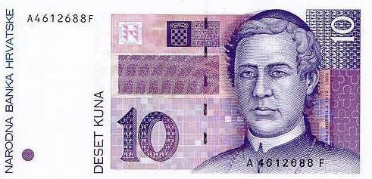
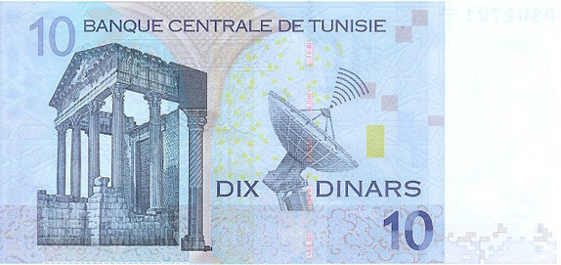
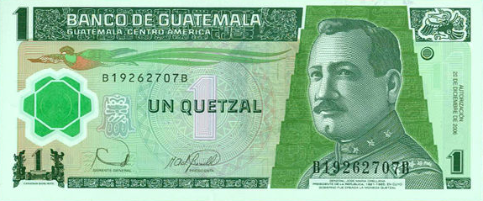
US$9.7 b
US$9.6 b (Sept. 2016)
Croatia
US$5.9 b
US$5.5 b
Tunisia
Guatemala

Slide 21
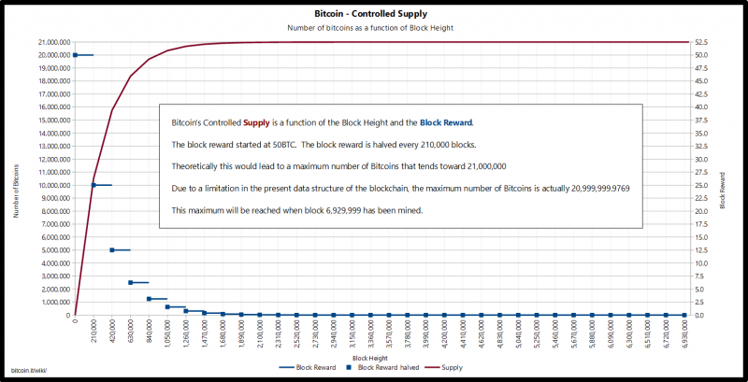
The reason for Bitcoins instability - its ‘monetary policy rule’

Slide 22
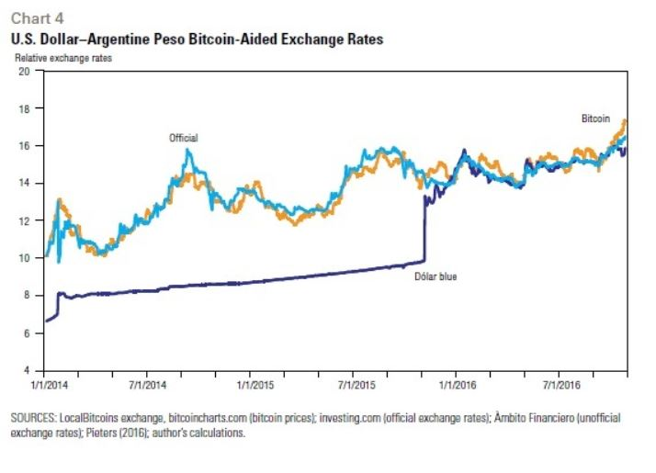
What Bitcoin is used for today (among otheer things…)

Slide 23
Hayek’s criteria for the ‘best’ crypto currency
Hayek:
It seems to me to be fairly certain that
a money generally expected to preserve its purchasing power approximately constant would be in continuous demand so long as the people were free to use it,
with such a continuing demand depending on success in keeping the value of the currency constant one could trust the issuing banks to make every effort to achieve this better than would any monopolist who runs no risk by depreciating his money,
the issuing institution could achieve this result by regulating the quantity of its issue, and
such a regulation of the quantity of each currency would constitute the best of all practicable methods of regulating the quantity of media of exchange for all possible purposes
”Denationalisation of Money”, 1977

Slide 24
Maybe the ideal crypto and the ideal central bank is really the same
 | Central bank (after 1992ish) | Crypto currency
Rules (vs discretion) | Inflation targeting (Taylor rule) | Algorithme
Autonomy (or control) | Independent CB | Decentralised system

Slide 25
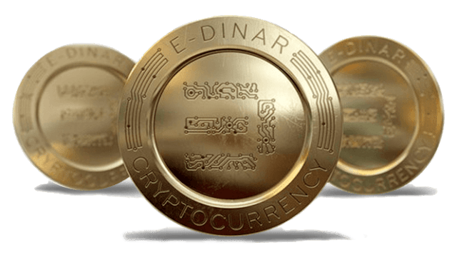
Central Bank issued Crypto Currencies (CBCC)

Slide 26
A vision – looking 10 years ahead (1)
Central banks and cryptos will converge:
New crypto algoritmes will try to stabilise purchasing power (development of variations of ‘stable coins’)
Economists and lawyers will move into the ‘Crypto space’
Tech geeks will move into the central banks
Central banks will introduce their own e-money and Central Bank issued Crypto Currencies (CBCC)
Politicians and regulators will have to accept that cryptos are here to stay
…and ‘crypto anarchists’ will have to accept regulation in some form (private or government)

Slide 27
A vision – looking 10 years ahead (2)
The crypto asset and currency markets in 10-15 years:
There surely will be a handfull of crypto currencies, which will be used in certain geographical areas (where the monetary system fails today)
There might be crypto currencies for certain market segments (regionally or sectorally) – for example in the gaming industry or in international trade
There will be a few crypto assets playing a similar role as gold is doing today working as a diversifier (image for example a crypto asset negatively correlated with stock prices)

